Slide 1

Artificial Intelligence For NLP Lesson-Final-9
人工智能与自然语言处理课程组

Slide 2

除了深度学习，为什么还需要经典的机器学习模型
Review
Backpropagation, Gradient Descent
The success of deep learning
RNN, CNN, Seq2Seq, Attention
Dimension Curse
The Bias of Deeplearning

Slide 3
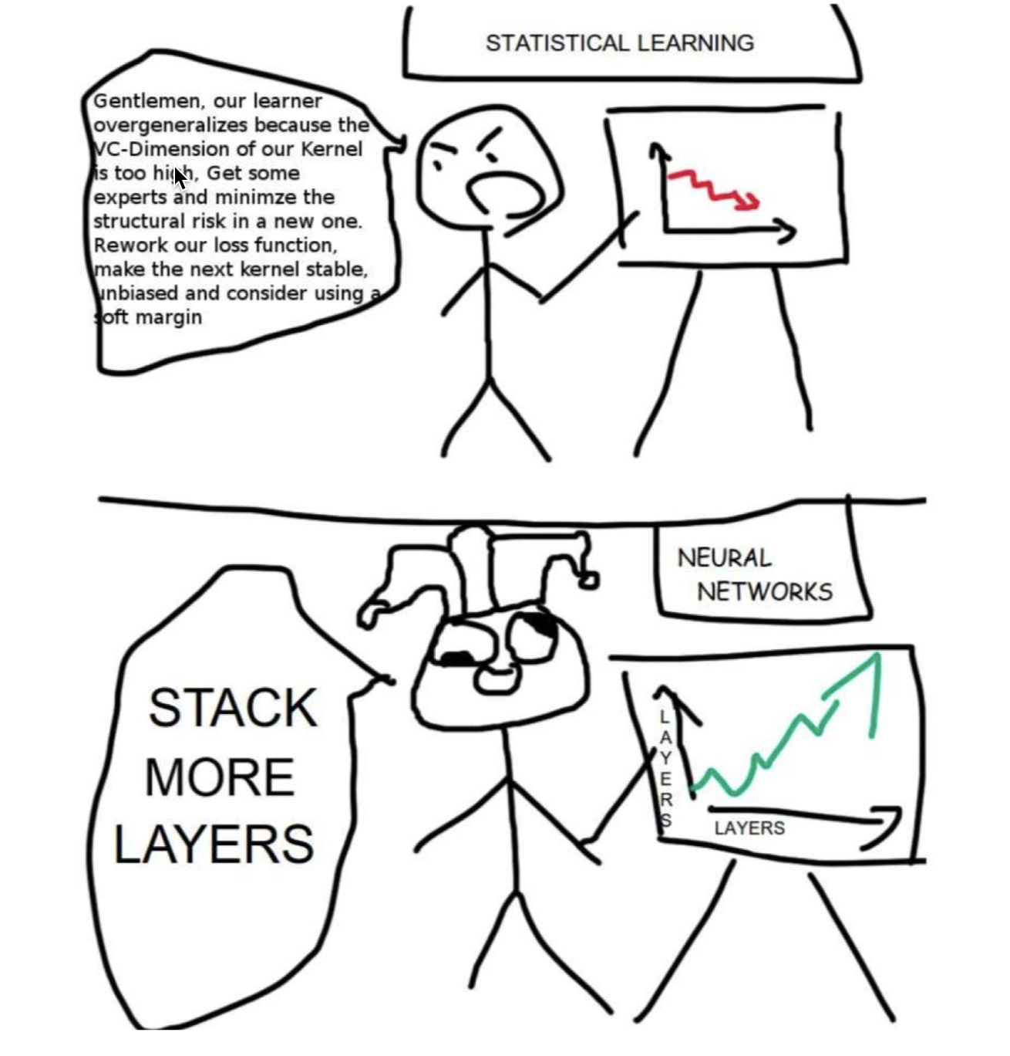
深度学习为何如此成功？

Slide 4
My curve is better than yours

Slide 5
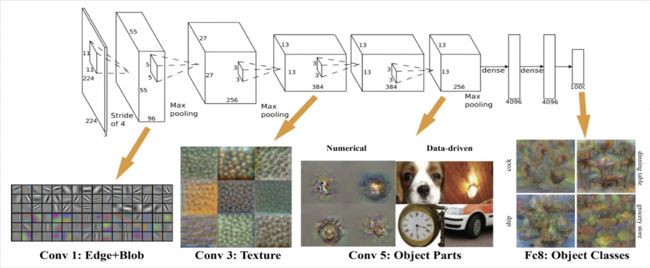
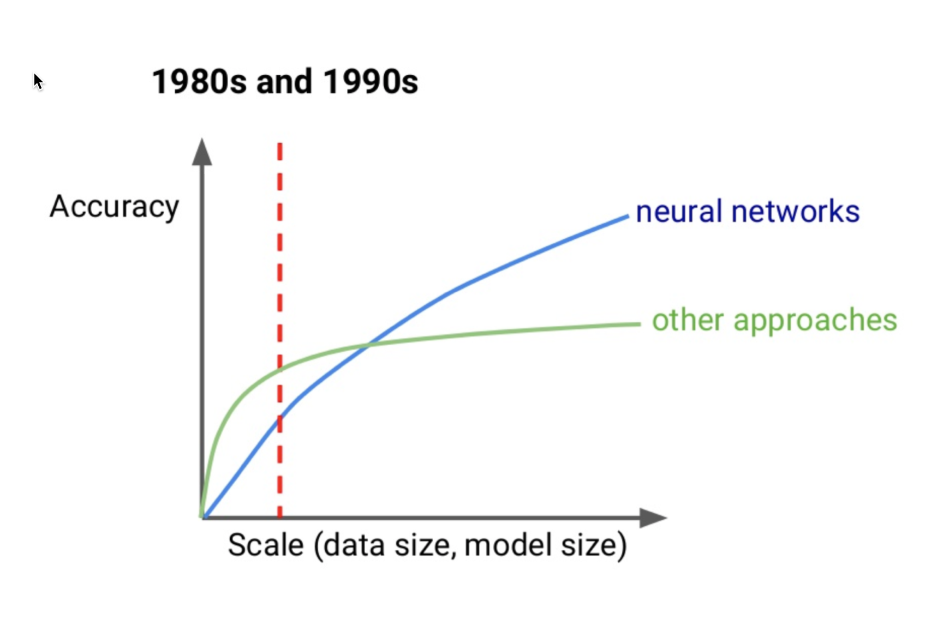
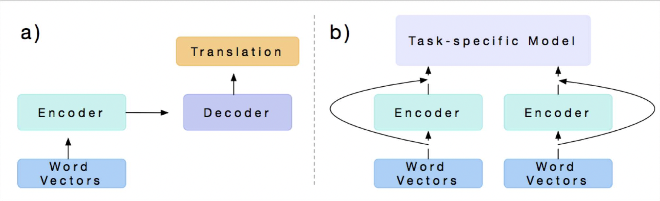

Slide 6
Dimension Curse
Parameters Need Data More and More!

Slide 7

Bias in the CV and Language of Artificial Intelligence 人工智能中的公平性与不可测性

Slide 8
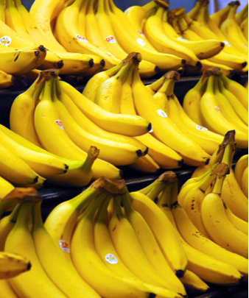
你看到了什么？
香蕉
标签
商店里的香蕉
货架上的香蕉
贴着贴纸的香蕉
但是没有人会说：黄色的香蕉

Slide 9
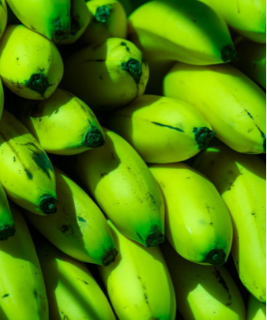
绿香蕉
没熟的香蕉

Slide 10
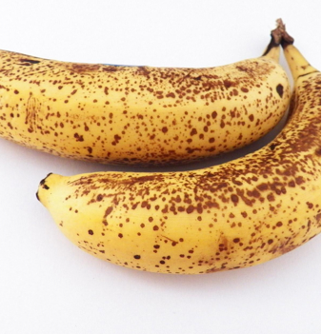
成熟的香蕉
坏香蕉

Slide 11



One purpose of categorization is to reduce the infinite differences among stimuli to behaviourally and cognitively usable proportions

Slide 12

一个爸爸带着他的儿子冲进医院要求做手术，手术医生说：“我做不了这个手术，他是我儿子！
为什么？

Slide 13

一个爸爸带着他的儿子冲进医院要求做手术，手术医生说：“我做不了这个手术，他是我儿子！
为什么？

Slide 14



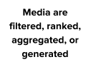

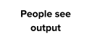


Slide 15
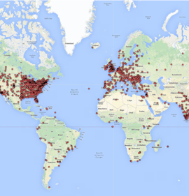
Bias in Data Selection does not reflect a random sample
土耳其机械工人的分布图

Slide 16





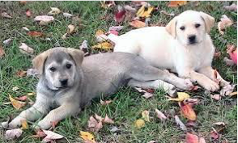
Biases in Data

Slide 17
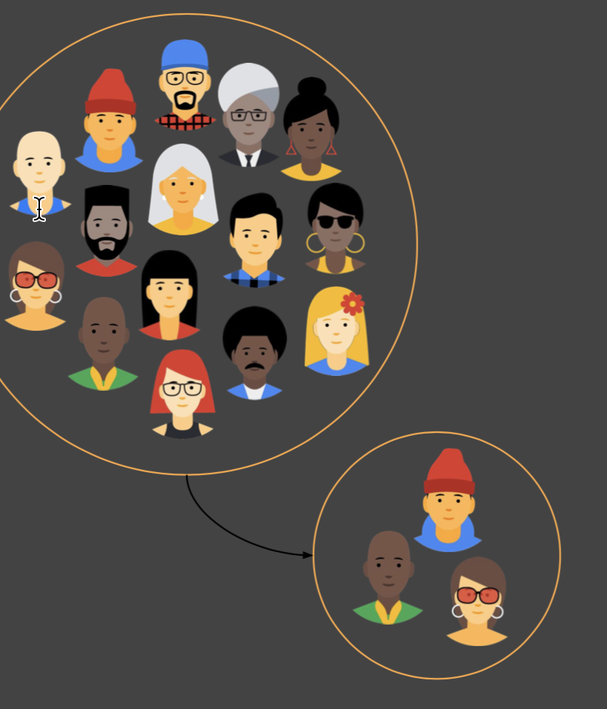
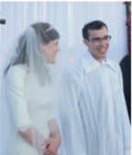
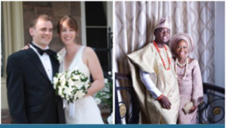
It's possible that you have an appropriate amount of data for every group you can think of but that some groups are represented less positively than others.
婚礼、新娘，西服、婚纱
黑人

Slide 18
Biases in Interpretation 对AI结果解析的问题

Slide 19
Hard to Explanation, Religion

Slide 20
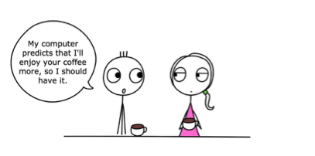
辅助决策的误区

Slide 21
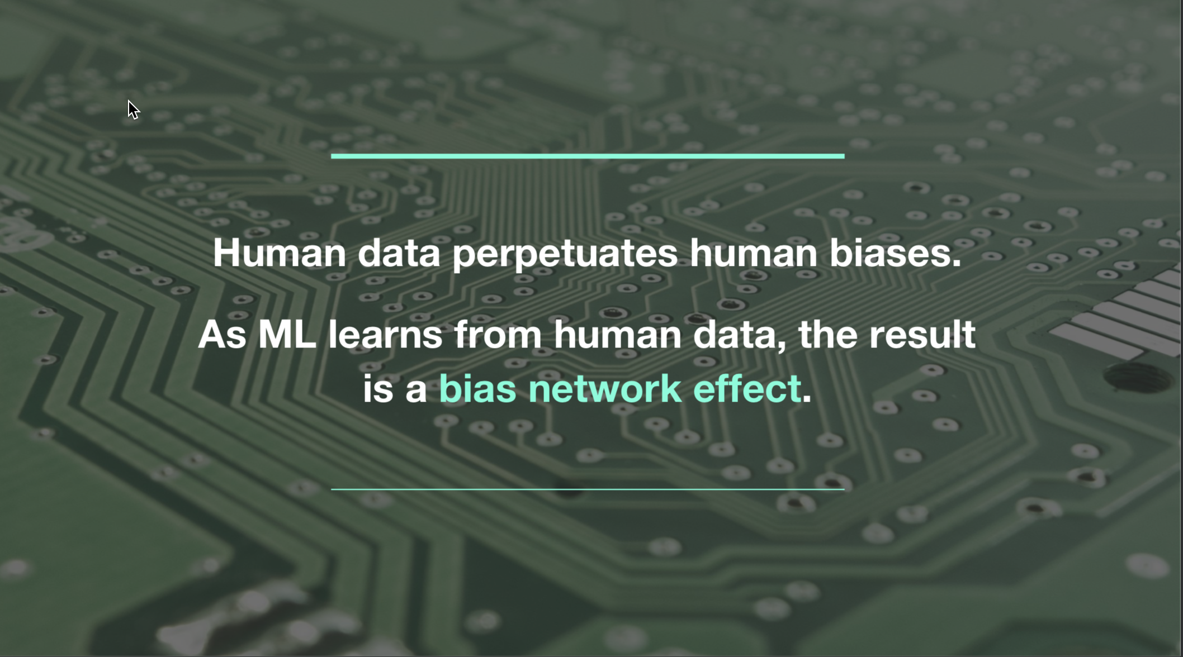

Slide 22
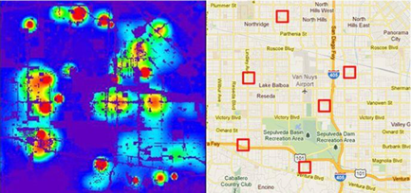
Predicting Policy
Algorithms identify potential crime hot-spots
Minority Report（少数派报告）

Slide 23
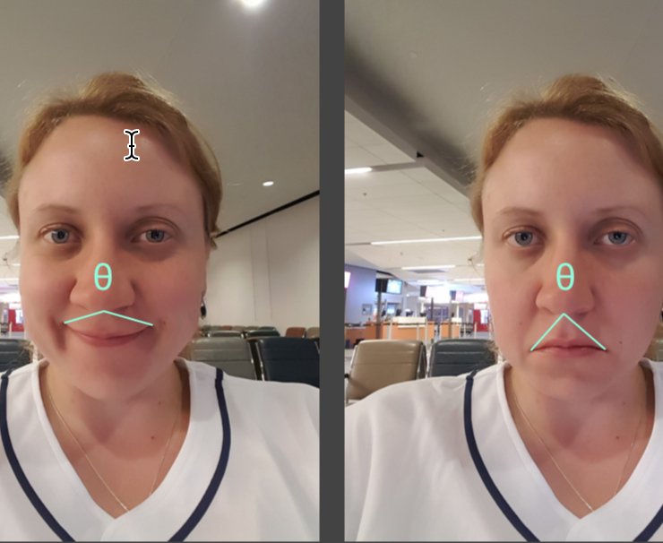
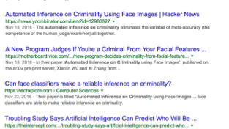
Predicting Criminality

Slide 24
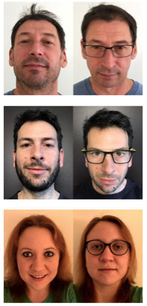
Predicting Homosexuality 同性恋预测
Wang and Kosinski, Deep neural networks are more accurate than humans at detecting sexual orientation from facial images, 2017.

Slide 25
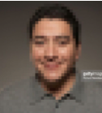

Why do we need to concern it?

Slide 27
结论1： 深度学习不能解决所有问题，尤其是需要强大的数据支持的时候，从数据层面，就会有很大问题！
结论2： 深度学习因为其结构的复杂性，模型基本上不能解释，出了错，也找不出来哪里是错的，从而几乎无法进行提升！

Slide 28
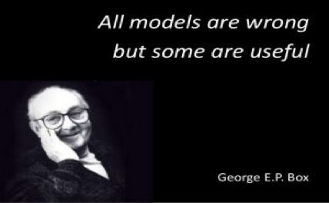
What’s model?

Slide 29
The Simplest Machine Learning Model
Only have 50 points data
How can you predicate?
Using Neural Network?
Overfitting?
Underfitting?

Slide 30
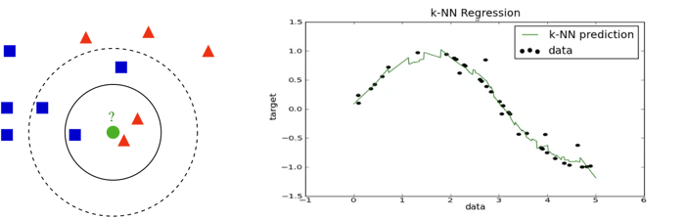
Regression and Classification

Slide 31
K-Neighborhood Nearest
(Online Coding)

Slide 32
KNN Model
If we want write a program solve it, it’s simple.
1-nearest neighbor classifier / regression
Weighted nearest neighbor classifier / regression
Maybe all the machine learning problem could use this method.
Dimension reduction
With the dimension increase, we need much more data to fit.
Euclidean distance is unhelpful in high dimensions because all vectors are almost equidistant to the search query vector. (Image a circle)
Outliner
Memory Consuming
Timing Consuming in high dimension

Slide 33
Better Explanation
If some results are error
We could find the reason easily.

Slide 34


Lazy-Learning and Eager Learning
Lazy Learning: Target function will be approximately locally;
Dataset with few attributes.

Slide 35
Review
1. The limitation of Deep learning
2. The Bias of Deep learning
3. Dimension Curse
4. What’s the Model
5. K-Neighborhood Nearest Model
Next:
Decision Tree
Random Forest
Bayes
Support Vector Machine
K-Means

